Slide 1
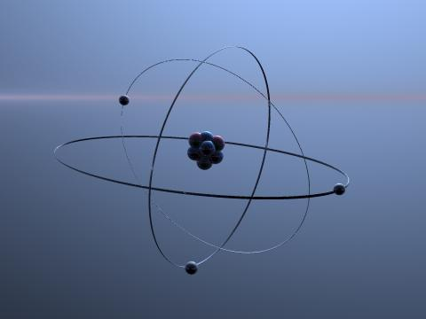
Network Covalent

Slide 2
Activity
Carbon can form covalent bonds?
DRAW DOT CROSS DIAGRAMS TO SHOW THIS!
LESSON OBJECTIVES
To state the differences between a simple covalent molecule and a Giant Covalent compound.
To show this with dot cross diagrams and stick diagrams.
Make an Analytical comparison between the types of bonds looked at today.

Slide 3
WHAT DOES THE WORD GIANT IMPLY?
Bigger
Better
More Than
STRONG!

Slide 4

INFACT! All covalent bonds are strong
O2
O ____ O
So WHY?? Is Oxygen a Gas???

Slide 5
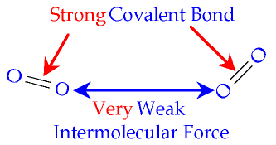
WEAK INTER-MOLECULAR FORCES
Discrete molecules

Slide 6
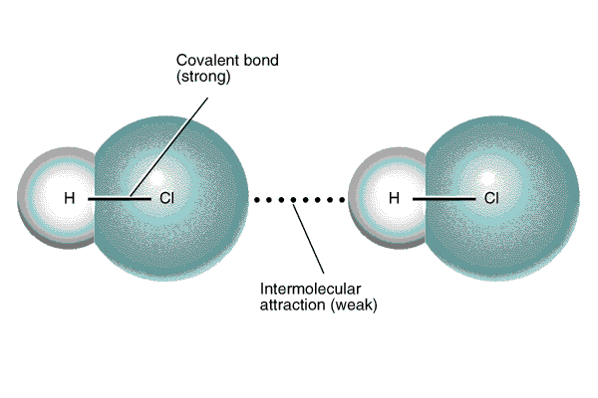
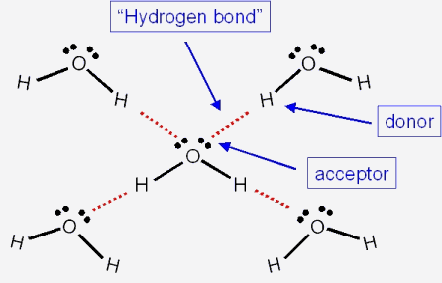
Simple Covalent Compounds
So if a compound has weak inter-molecular forces between the molecules it is a simple covalent compound.
This would mean its a Liquid (l) or a Gas (g)!

Slide 7
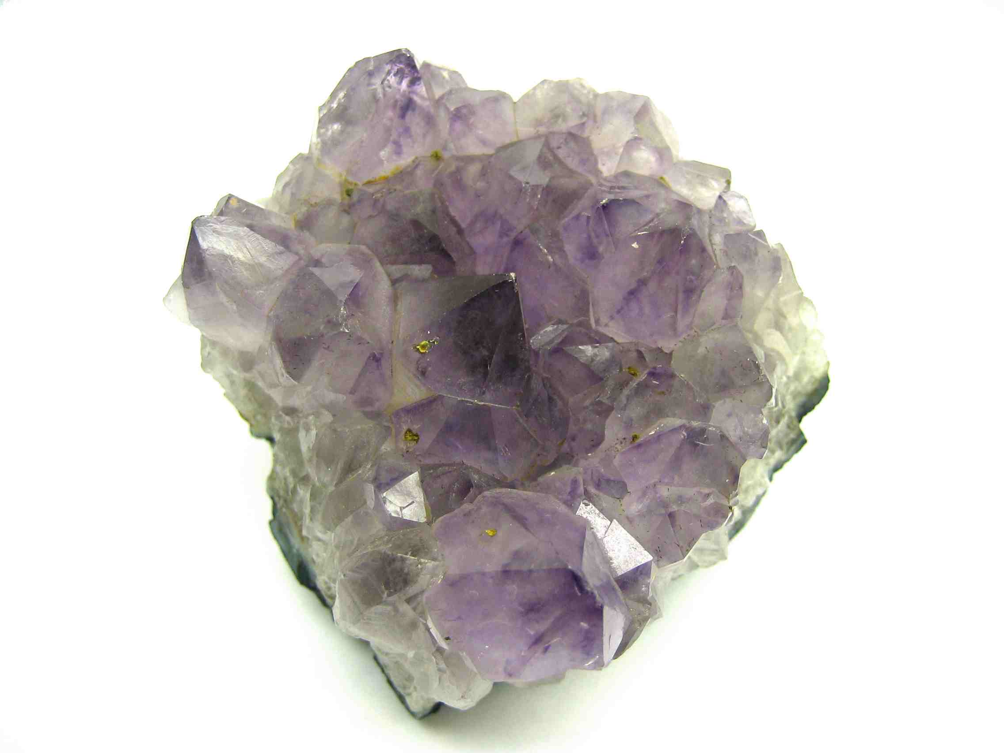
Giant Covalent Compounds
If however the covalent bonds keep on going.... Like in a polymer the compound or element would produce a NETWORK COVALENT STRUCTURE
for example in rocks... SiO2 (Silicate or Quartz)

Slide 8
WHY DOES CARBON FORM SO MANY COMPOUNDS?

Slide 9
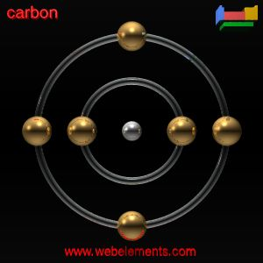
WHAT IS ITS ATOMIC STRUCTURE?

Slide 10
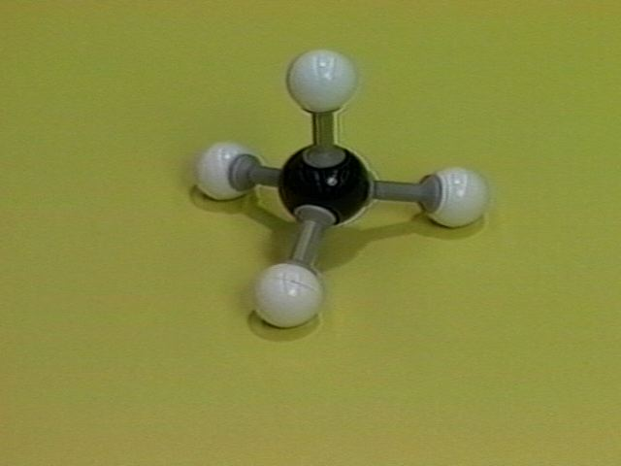
FIRST REASON:
You can see that Carbon has FOUR electrons in its outer shell. These are used for bonding purposes with other elements
Here is a simple example:

Slide 11
Carbon can bond to other carbon to form long chains
When the Carbon bonds to the Hydrogen ALL the electrons are used for bonding.
When the Nitrogen bonds to the Hydrogen, only THREE electrons are used for bonding.
The remaining two are called the LONE PAIR and they decrease the stability of the compound

Slide 12
SECOND REASON
Carbon forms compounds which have single, double and triple bonds between its own atoms.
One bond – one pair of electrons being shared
Double bond – two pairs of electrons being shared
Triple bond – three pairs of electrons being shared

Slide 13
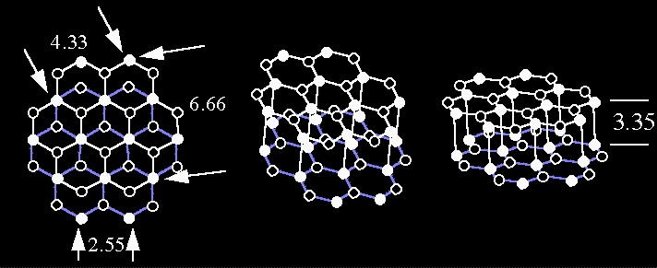
Graphite – Carbon “Called Allotropes”

Slide 14
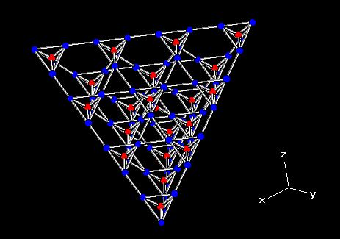
Diamond – Also Carbon “Called Allotropes”

Slide 15
Simple vs Giants Properties
Can they conduct electricity?
Solid, Liquid or a gas?

Slide 16
Look At the Data Sheet
What were the properties of ionic bonds?
What do you notice about most of the covalent boiling points?
What about the giant covalent boiling and melting points?
What does this tell us about the covalent bond itself?
Do the compounds dissolve in water? Which ones? What types of bonds are they?
Can you draw Lewis Diagrams of 5 ionic and 5 covalent molecules from this list?

